Slide 1


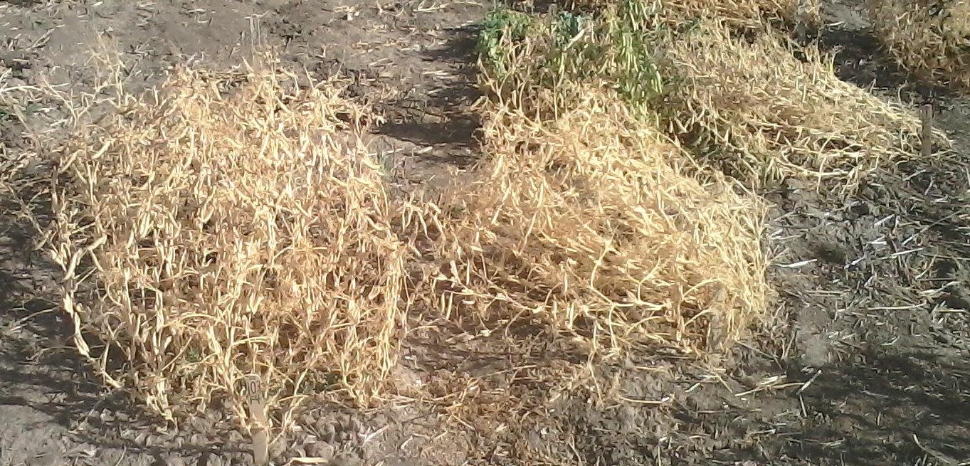
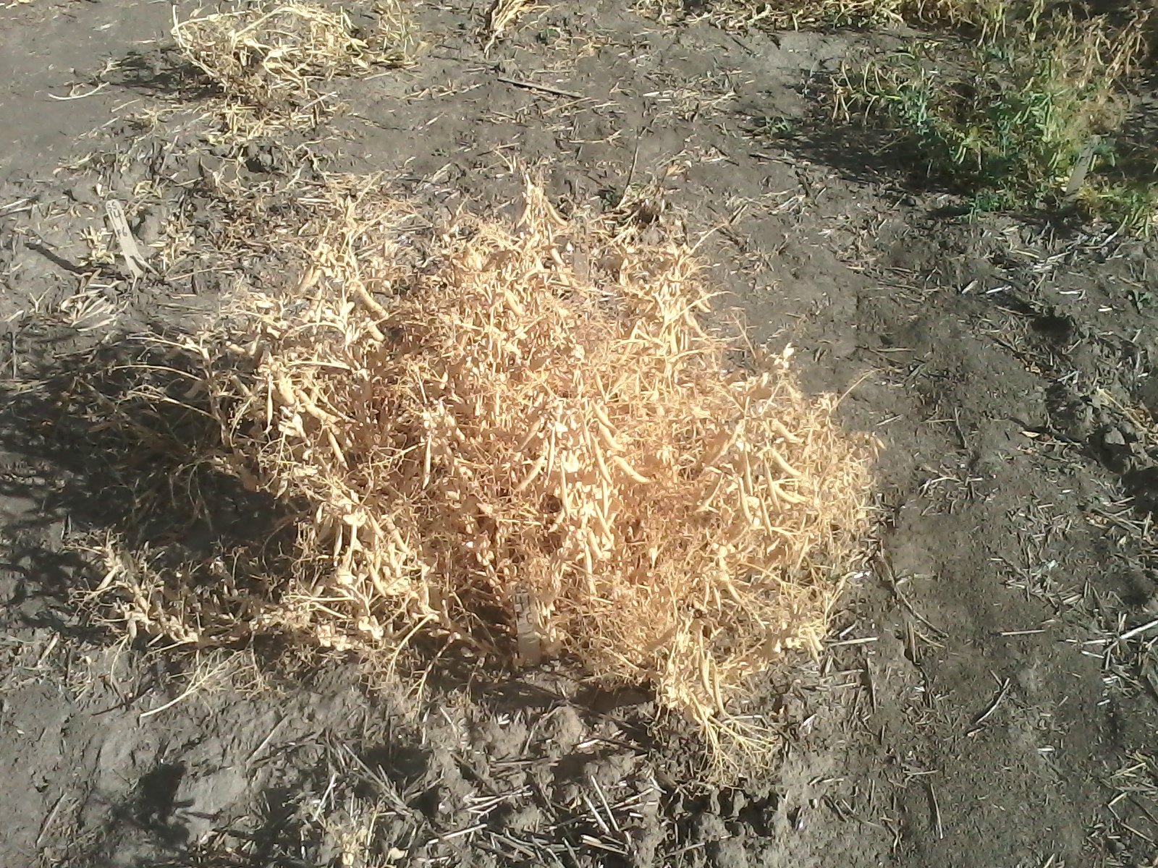
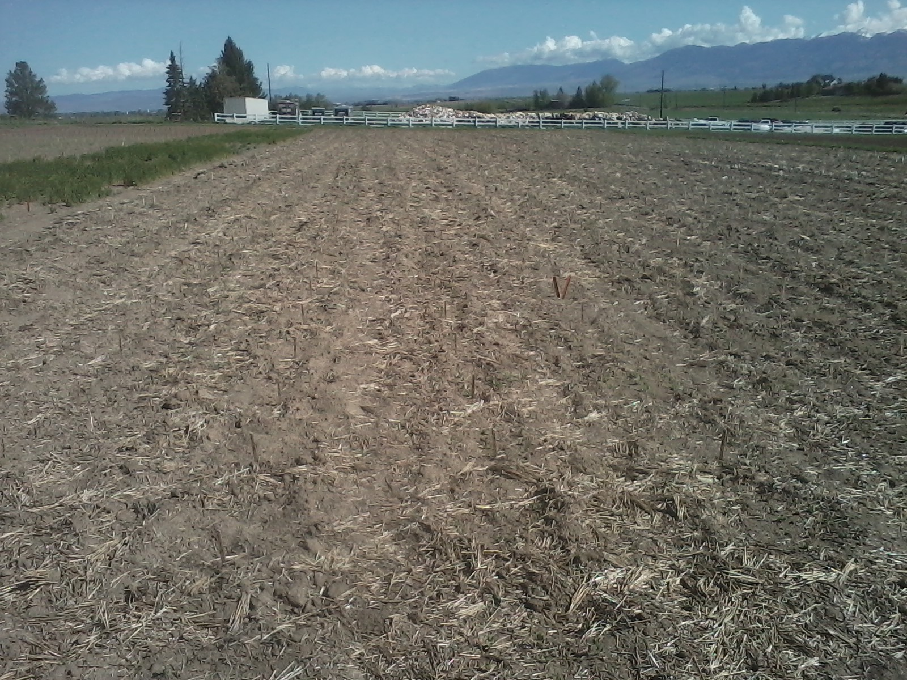
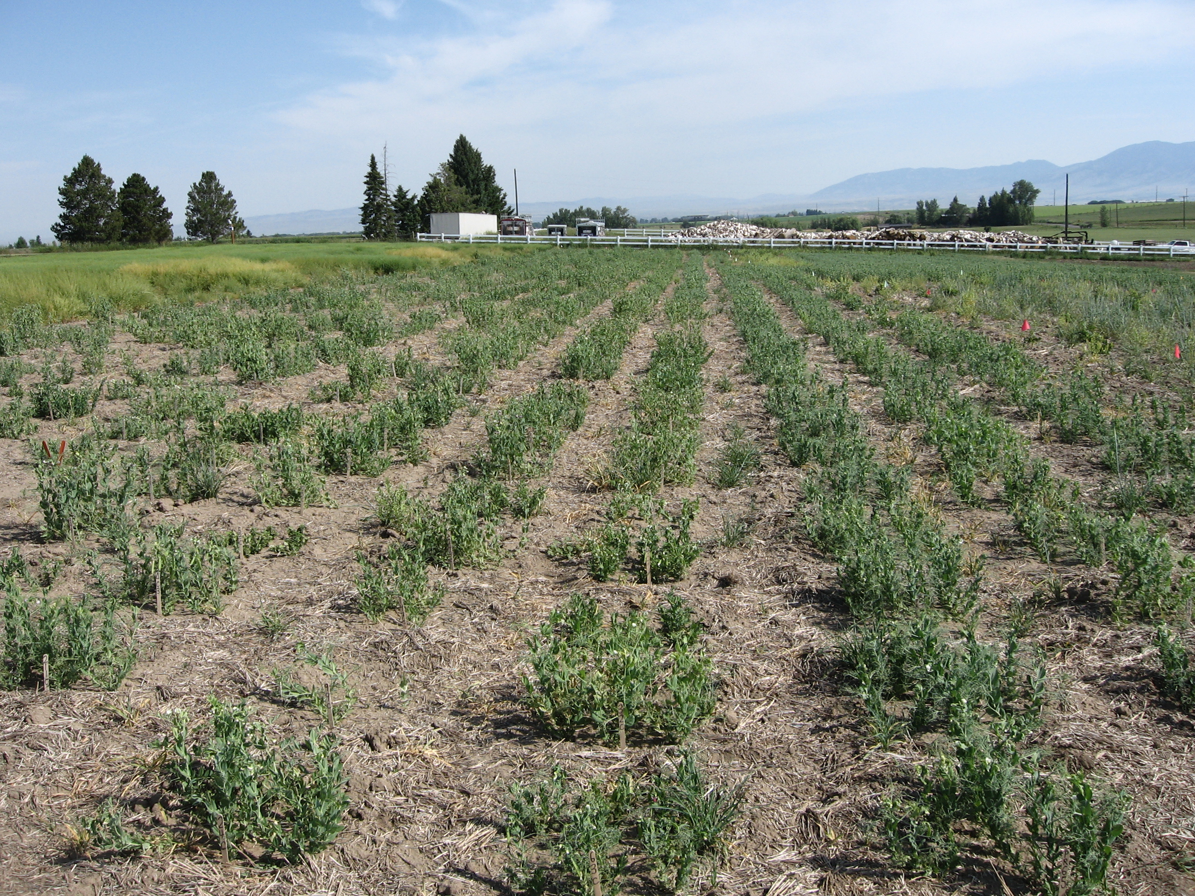
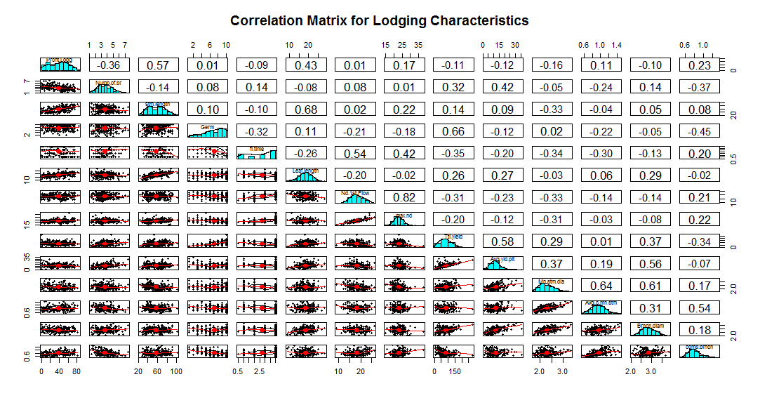
QUANTITATIVE TRAIT LOCI ASSOCIATED WITH STEM STRENGTH AND LODGING IN DRY PEAS
By J.A. Smitchger and N.F. Weeden
Goals
Find the location of the genes affecting lodging in peas and develop genetic markers to be used in marker assisted selection for lodging resistance.
Introduction
Field pea is an excellent rotation crop which leaves nitrogen in the soil for the following wheat crop, breaks disease cycles, and facilitates rotational weed control. Since the year 2000, Montana pea acreage has increased 27 fold to 570,000 acres. Lodging in peas promotes disease and impairs machine harvest. Breeding new pea varieties is difficult because there is only a partial understanding of the genetic causes of lodging in pea.
An erect line and a lodged line
A moderately branched, dwarf, afila, erect line.
Results
Multiple pleiotropic effects were seen for various traits. Significant associations were found between Mendel’s tall/dwarf gene (le), the semileafless mutation (af), basal branch number (which was associated with Mendel’s flower locus a), tendril length, compressed basal branch diameter, and lodging. Literature has indicated that increasing compressed stem thickness would decrease lodging in pea, but the correlations are weak and contradictory. Lodging actually increased with increased compressed basal branch diameter and decreased with increased main stem diameter. Mendel’s height gene influenced a large number of traits due to the change in gibberellin levels. Small plot yield was influenced by leaf length, basal branch number, flowering time, and stem diameter.
Materials and Methods
A relatively wide cross was made between a wild type line and a commercial pea variety (Delta).
Approximately 250 F2 progeny were advanced via single seed descent in order to create a set of recombinant inbred lines (RIL).
Ten seeds were planted for each line in three replications near Bozeman and Moccasin, Montana.
Field data was collected for 14 quantitative traits, and several categorical traits which might be linked to lodging resistance.
A correlation matrix was created to discover correlations to lodging and pleiotropic effects among various traits.
Genotyping will be done via genotype by sequencing (GBS).
Conclusions
Mendel’s dwarfing gene (le) and the semileafless mutation (af) account for approximately 30% of the variation in lodging in this population.
Another important QTL affecting basal branch number is near Mendel’s flower color locus (a).
Number of basal branches is positively correlated with lodging resistance and explains approximately 13% of the variation in lodging.
It is unknown whether an added number of basal branches has an effect on basal strength, which might influence lodging.
This data can be used to discover genetic markers for major traits influencing lodging resistance and other important characteristics in pea, allowing for faster selection.
After Planting 2015
Summer 2015
Legend
Column 1=Percent lodging; Column 2=Number of basal branches (includes main stem); Column 3=Length of the main stem; Column 4=Number of plants germinated out of 10 seeds planted; Column 5=flowering time rated on a 1-4 scale; Column 6=Length of the compound leaf/tendril; Column 7=Nodes to first flower; Column 8=Maximum number of nodes attained before senescence; Column 9= Total yield per plot; Column 10=Average yield per plant; Column 11=main stem diameter; Column 12=Average compressed main stem diameter; Column 13=Branch diameter; Column 14=compressed branch diameter.

